Slide 1
CHAPTER 4
VOICE COMMUNICATIONS

Slide 2
PSTN
Public Switched Telephone Network
  Based on star, ring or mesh topologies
  Consists of transmission paths and nodes
  Originally designed to carry voice but being used more and more to carry data
Nodes
  Exchange or switching points where two or more paths meet, enabling the users to share transmission paths

Slide 3
Switching
Switch
  Sets up a communication path on demand and takes it down when it is no longer needed
Switching
  Routing information to different parties

Slide 4
Switching System Components
Switching matrix
Controller
Database
Line circuits
Trunk circuits
Common equipment

Slide 5
Characteristics of Switching Systems
Blocking networks
  Older networks with fewer paths than terminations so all users cannot be served simultaneously
Non-blocking networks
  Enable a connection independently of the amount of traffic
Virtually non-blocking networks
  Compromise between blocking and non-blocking networks

Slide 6
Key Terms in Switching Systems
Common control systems
  Translation of the telephone number, automatic call routing, digit conversions, and trunk signaling
Direct control systems
  Lack alternate routing and digit translation capabilities
Virtually non-blocking
  Not totally non-blocking but provides enough paths so users are rarely blocked
Busy Hour Call Attempts (BHCA)
  The number of calls the system can handle during peak hour
Concentration or line-to-trunk ratio
  Determines the probability that a call will be completed

Slide 7
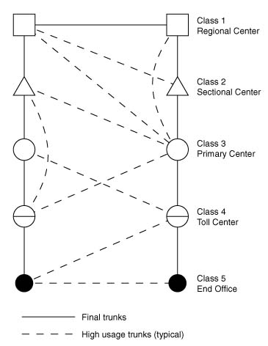
Telecom Infrastructure Hierarchy

Slide 8
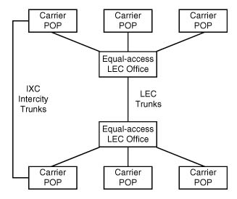
LEC and IXC Network Structure

Slide 9
Telephone Cable Architecture
Telephone Cable Hierarchy
  Trunks (in North America, that are same as “Junctions” in Europe)
    High-speed digital carriers that interconnect nodes
  Feeders
  Branch Feeders
  Station Drops (local loops, subscriber lines)
    One pair of UTP wire that is usually analog

Slide 10
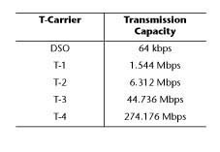
T-Carriers and their
Transmission Capacity

Slide 11
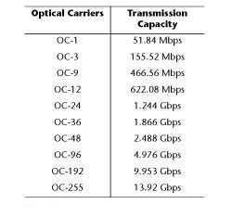
Optical Carriers and their Transmission Capacity

Slide 12
Line Conditioning
Line Conditioning
  Is used to tighten telephone company parameters so that they can transfer data at higher speed with reduced errors
Propagation delay
  Time taken by a signal to travel from source to destination and “envelope delay distortion” measures the variance in propagation delay within the voice band
Attenuation distortion
  Gain fluctuations with frequency

Slide 13
Analog versus Digital Telephone
Distinction between the analog versus digital telephone is where the Codec is located.
  If it is inside the telephone, it is digital.
  If the Codec is in the telephone company’s equipment, the telephone is analog.

Slide 14
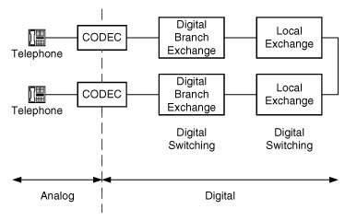
Analog versus Digital Telephone

Slide 15
The Telephone
Telephony
  Science of translating sound into electrical signals
Tip and Ring
  Transmit and Receive wire that connect the instrument to a plug in the wall using RJ-11 jack

Slide 16
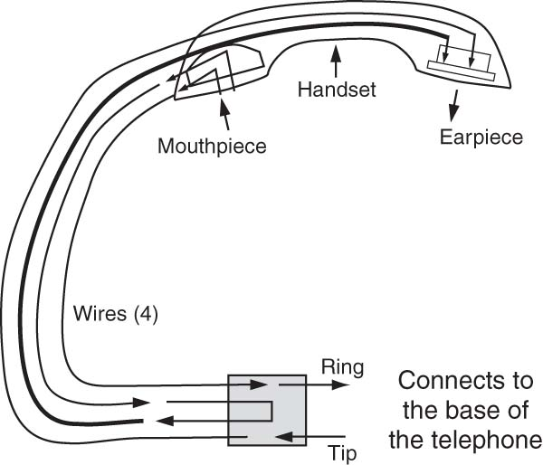
The Telephone: Tip and Ring

Slide 17
Outgoing Call
Pulse Dial
  In general, pulse repetition rate is between 8 and 11 pulses per second (pps)
Dual Tone Multiple Frequency (DTMF)
  Most commonly used signaling system today
  More reliable and faster than “pulse dial”
  Transmission rate is 7 digits per second
  Consists of a frequency matrix
Multi-Frequency (MF)
  Used on trunk circuits
  Transmission rate is 7 digits per second

Slide 18
Incoming Call
Ringer Equivalence Number (REN)
  Is used to ensure that the local exchange can provide the correct amount of power required to ring the telephone
The Ring voltage is about 90 to 105 volts AC with a frequency of 20 Hz
The –48 volts DC that is always on the line operates the telephone when it is being used

Slide 19
Line Signaling: Loop Start
Current flows only when the phone is off-hook
Local exchange senses that and provides a dial tone
No need for accurate ground references between the local exchange (remote end) and the telephone (local end)
Tip and Ring wires may be reverse
Problem of “glare” (when both the local end and the remote end attempt to access the circuit at the same time)

Slide 20
Line Signaling: Ground Start
Usually used only on trunks and PBXs
Minimizes the possibility of “glare”
Tip and Ring wires cannot be reversed
Local end and remote end must be at the same potential

Slide 21
Trunk Signaling
Out-of-band
  Separate network to pass call setup, charging, and supervision information
In-band
  Carries call setup, charging, and supervision information over the same circuit
Advantages of out-of-band over in-band
  Lower susceptibility to fraud
  Lower setup time
  Capable of supporting virtual networks

Slide 22
In-band Signaling Methods
Single Frequency
  Most common in-band analog signaling system
  Idle or busy status indicated by the presence or absence of a 2600 Hz tone in the U.S.
E&M Signaling (recEive and transMit)
  Used on digital four-wire circuits
  Type I: Common in North America
  Type II: Usually on Centrex circuits
  Type V: Most popular outside North America

Slide 23
Out-of-band Signaling Method
Common Channel Signaling
  Most common out-of-band signaling system
Signaling System Seven (SS7) Standard
  HDLC-based protocol developed by CCITT
  Uses layered protocol that resembles the OSI model
  Message Transfer Part of SS7 (bottom three layers of OSI) Telephony User Part (top four layers of OSI)
  Components:
    Service Switching Point (SSP) or Action Control Point (ACP)
    Signal Transfer Point (STP)
    Service Control Point (SCP) or Network Control Point (NCP)

Slide 24
Intelligent Network Services
Caller Identification
Automatic Call Distribution (ACD)
  Distributes calls evenly among multiple agents
Voice processing systems
  Interactive Voice Response (IVR)
    Example: Users selecting an option using voice
  Automated Attendant or Auto Answer (AA)
    Example: Automatic greeting followed by ACD
  Voice mail
    Example: Electronic mailbox

Slide 25
Different Types of Telephone Lines
ISDN line: All-digital transmission line
T-1 line: Digital high-capacity phone line
Tie trunk: Point-to-point connection
DID (Direct Inward Dial) line: Dials extensions directly without the intervention of an operator
DOD (Direct Outward Dial) line: Uses an access code
FX circuit: Provides users with a local telephone number for a remote location
Toll free line: Reverse billing service

Slide 26
PBX
Private Branch Exchange (PBX)
  Popular choice for large businesses
  Enables switching of in-house calls
  Much less expensive than connecting an external line to every telephone
  Provides centralized support such as voice mail
  Highly reliable but they are big, expensive, and difficult to configure

Slide 27
Centrex
Centrex (Central Office Exchange Service)
  Popular choice for small-to-medium sized businesses because it provides the features of a PBX without having to buy one
  Service offered by the telephone company where most of the equipment resides
  Special circuit called Station Message Detail Interface (SMDI) links the local exchange to the Centrex customer

Slide 28
Network Design Parameters
Grade of Service (GoS)
  Ratio of the number of lost calls to the total number of attempted calls, same as the probability of blockage.
  The lower the number the better the system (A GoS of 0.01 is better than a GoS of 0.05)
Grade of Service = Number of lost calls
Number of attempted calls

Slide 29
Network Design Parameters continued…
Estimated Traffic
  Traffic is the term that quantifies usage. Usage or total traffic intensity is measured in centi-call seconds (CCS) = 100 call seconds of traffic in one hour. 36 CCS = 100% utilization
Network Design
  Trade-off between cost and quality of service
  Optimum designs: cost-savings while maintaining quality

